Slide 1

House data cleaning & exploration
1
Project summary with explanations and visuals
By pascal opara

Slide 2
CONTENTS
2
Introduction
Summary of Processes
Observation
Histogram & Boxplots
Missing Values Before Cleaning
Data Type Checked
Final Data Stats
Conclusion
References
Recommendation & Obstacles
Q&A

Slide 3
introduction
3
This project focuses on cleaning and exploring a dataset containing real estate information.
The goal was to make the data suitable for analysis by handling outliers, fixing missing values, and verifying consistency.
Visualisations such as histograms and boxplots were used to guide decisions during the cleaning process and visually detect outliers in numeric columns.
The final result is a clean and well-structured dataset ready for modelling or further analysis.

Slide 4
Summary of processes
4
Import the file
Upload the file
Read the file
Preview the file(First 5 rows)
Check the shape of the data (5000, 16)
See the data types – (right format or not)
Spotted HOA was in wrong format
Check for missing values
What needs to be cleaned and filled?
Get descriptive statistics:
to obtain, max, min and average values
Check outliers
Understand the data

Slide 5
OBSERVATION
5
Some columns contain clear outliers – sold_prices, lot_acres and bedrooms
One column contain invalid values (0) – year_built
One column has a wrong data type format - HOA

Slide 6
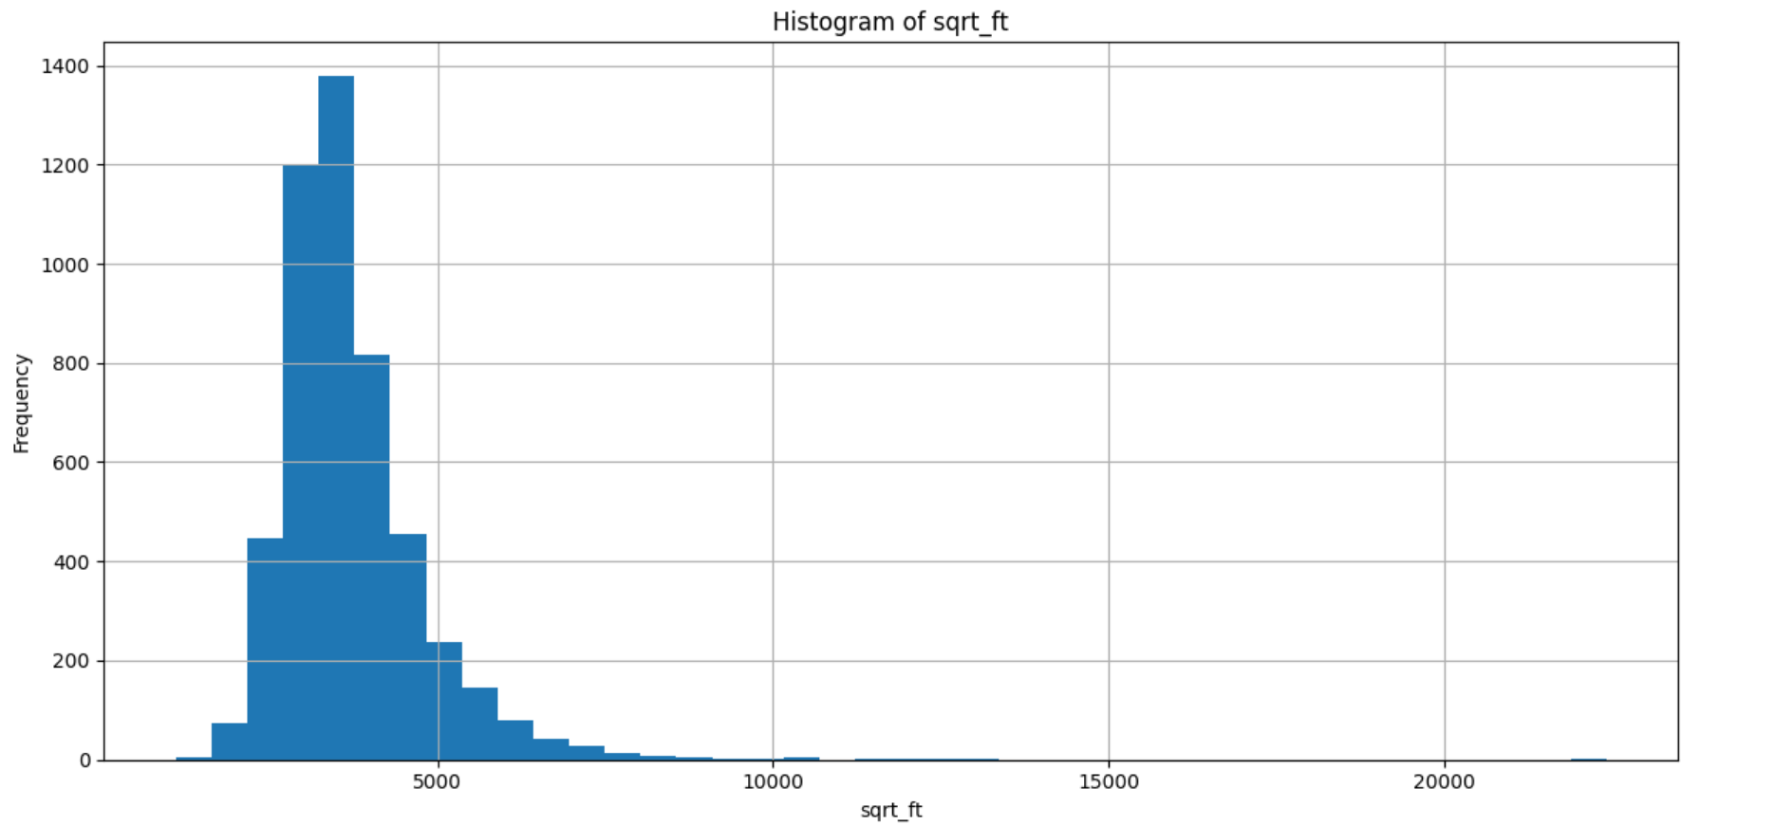
Histogram of sqrt_ft
6
Most house sizes fall between 1000-3000 sqft.
A few homes were extremely large (outliers).
Helped decide to cap sqrt_ft at 10,000.
Capping decisions were guided by visual analysis and at the point were the data started showing extreme values.

Slide 7
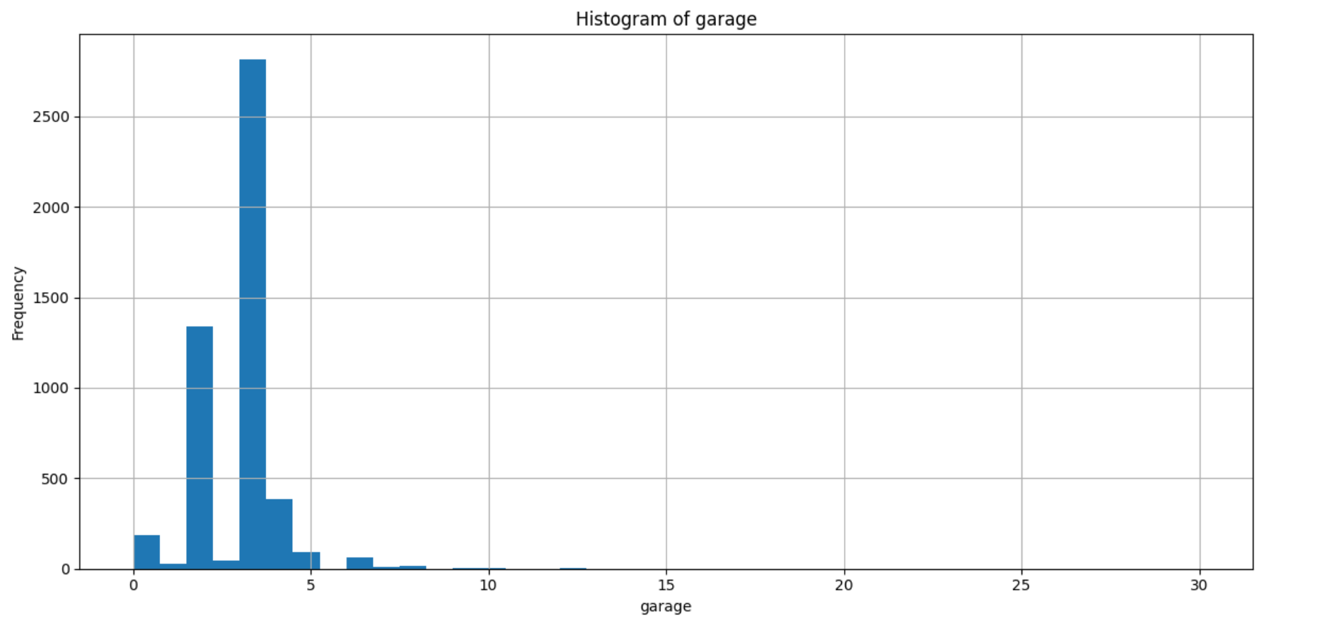
Histogram of garage
7
Most homes have 1-4 garage spaces.
Some rare entries had more than 6 up till 30.
These were removed as unrealistic as it could lead to skewed analysis.
Capped at 6

Slide 8
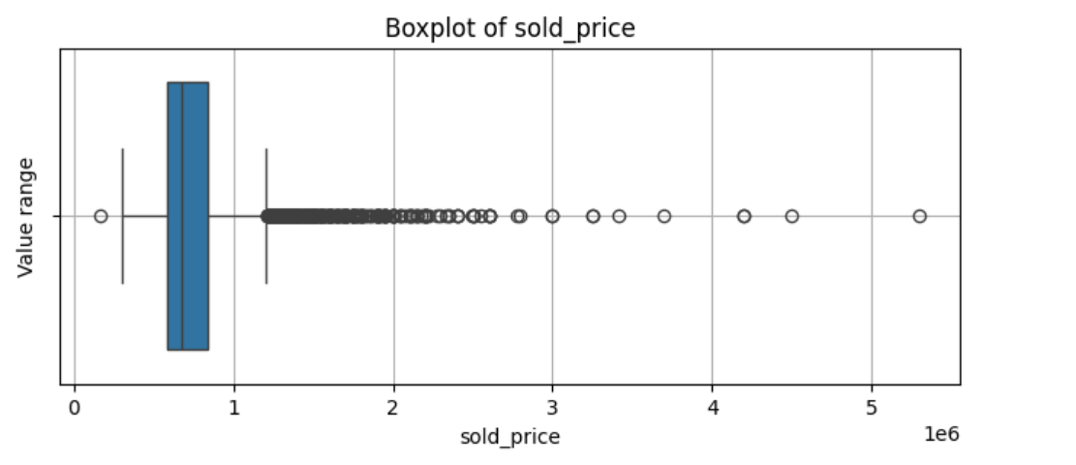
Boxplot of sold_price
8
Most homes sold under $1M.
Outliers above $2M were seen.
House price filtered above $2m
These were removed to reduce skew.
Distorts the distribution so the data is no longer symmetrical
Affects the visualization so the charts gets stretched and patterns harder to see

Slide 9
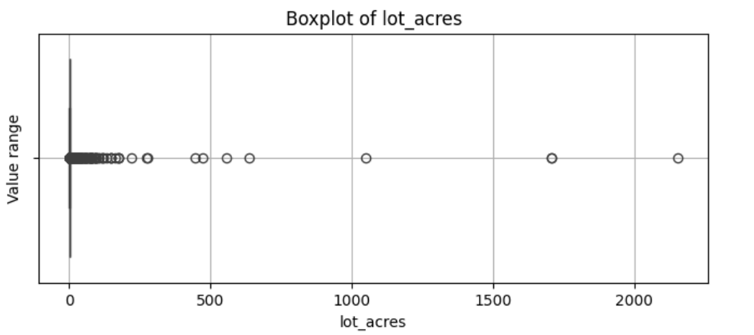
Boxplot of lot_acres
9
Most lots were small (under 1 acre).
A few lots were extremely large (2000+).
Capped lot_acres at 100 to clean this.

Slide 10
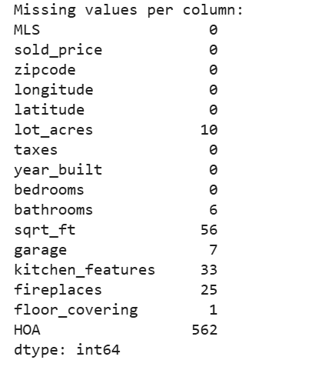
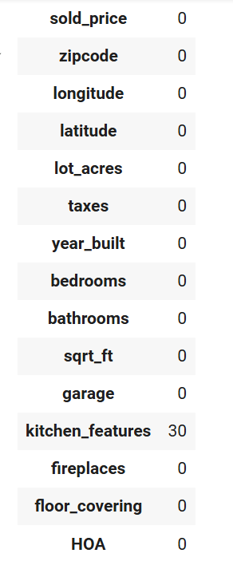
Missing values before cleaning
10
HOA and kitchen_features had missing values.
Kitchen_feautres were filled with ‘None’ to avoid gaps and retain usable data.
I converted the HOA column to numeric using pd.to_numeric() and filled any invalid or missing values to NaN and later to 0.
Other missing values were handled in cleaning.
Invalid entries (like 0 in year_built) were replaced with median to maintain realistic values.

Slide 11
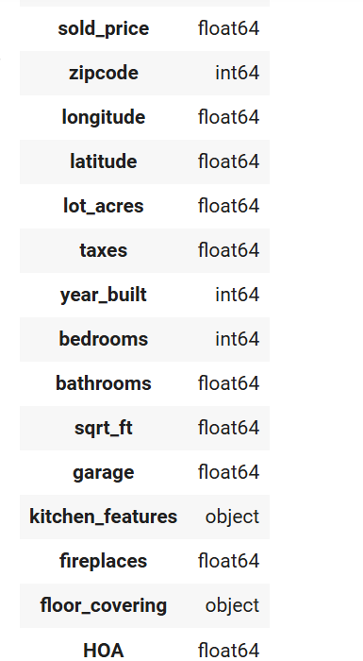
Data types checked
11
All columns were reviewed for correct data types and also to ensure consistency.
Numeric: float/int; Text: Object
Ready for saving and analysis.

Slide 12
Final dataset stats
12
Initial rows: 5000
Rows removed during cleaning: 180 (3.6%)
Final dataset: 4820 cleaned rows
No missing values remaining.
All data types verified.

Slide 13
conclusion
13
Visual exploration helped identify patterns and outliers.
Unrealistic and missing values were handled carefully.
Final dataset is clean, consistent and ready for modeling.
Each step was supported by visual checks and logical reasoning.

Slide 14
References
14
Python for Data Analysis by Wes Mckinney
Hands-On Data Analysis with Pandas by Stefanie Molin
Data Cleaning in Pandas by Data School – YouTube Video
EDA in Python(with Pandas and Seaborn) by Krish Naik – YouTube Video
Pandas Tutorial for Beginners by Corey Schafer – YouTube Video
Pandas Documentation
Towards Data Science articles

Slide 15
Recommendations and obstacles
15
Obstacles Faced
Missing values
Wrong Data types
Outliers and Skewed distribution
Unrealistic Values – 0 for year_built and 35 for bathrooms
Recommendations
Regular Data Audits – Periodic checks to catch issues early.
Use more descriptive column names – MLS, HOA and sqrt_ft
Define Valid Ranges for key Columns – set reasonable limits for columns like bedrooms, sold_price, garage and lot_acres to reduce outliers
Standard missing value indicators – use a uniform placeholder like NaN, None instead of mixing.

Slide 16
Q&A
16
Any Questions

